Slide 1

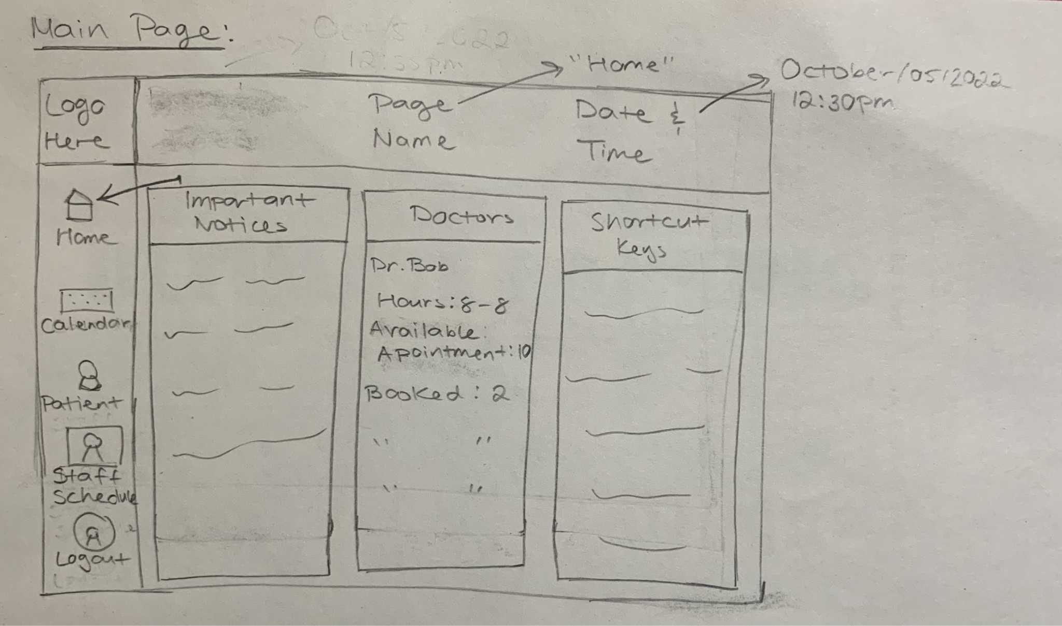
Calcare Wireframes
Ricky, Vardhini, Quyanna, Farhan, and Haris

Slide 2
Outline
Project Topic & Context
Prototypes
Task Walkthrough
Notes:
Today we will talk about who we are, go through some key design prototypes, and will provide a step by step task walkthrough

Slide 3
Project Topic
“11. A medical clinic would like to give its front-line staff a tool that will help them manage patient requests for appointments with particular doctors.”

Slide 4
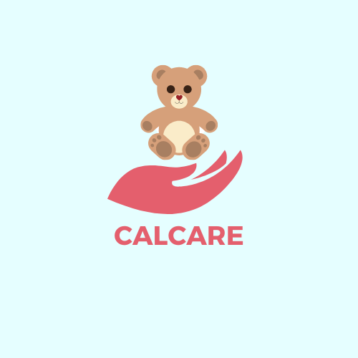
Project Context
We are CalCare!
Our product is a patient scheduling application that can be used in various medical facilities including Medical Clinics, Laboratories, and Hospitals.
The application will be used by frontline workers at these locations which will includes nurses, medical administrators, and receptionists.

Slide 5
Shortcut keys allow easy use.
Main Page
Notes:
This is what the main page of our application would look like, It’ll contain the date and time as well as customizable useful features for the receptionist to use. These can include important notices, doctors’ schedules/information, and shortcut keys that can provide easy access to other tasks that are performed on a daily basis such as booking in a patient for example.

Slide 6
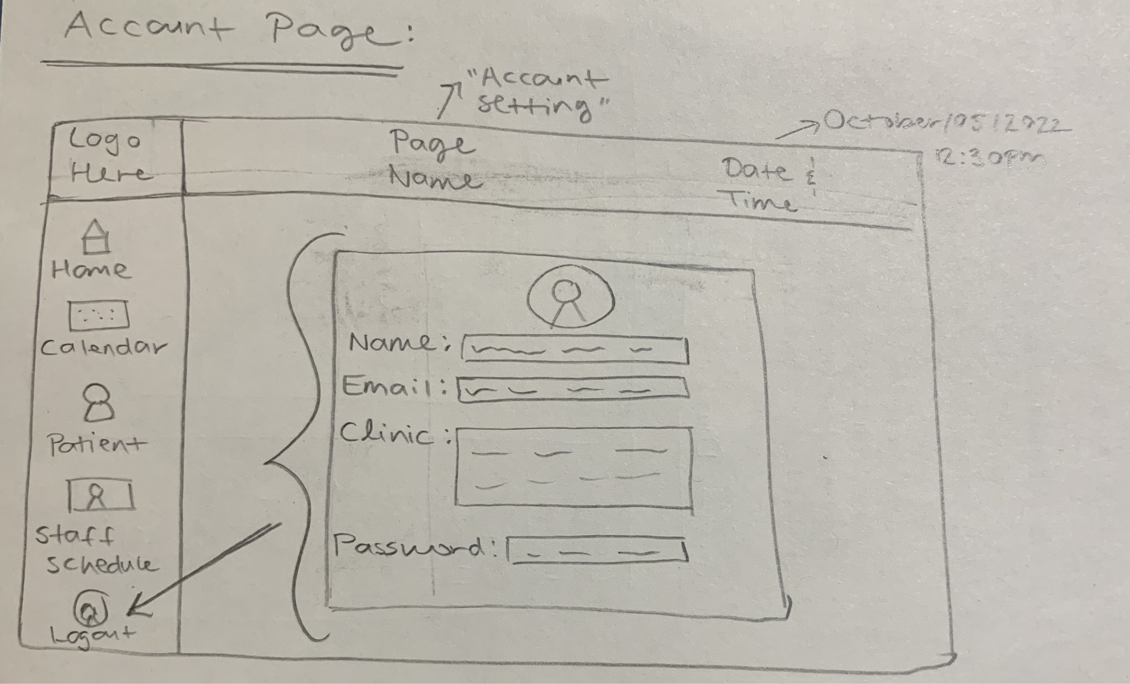
Taskbar for ease of navigation.
Account Page
Notes:
Editing account
Task bar

Slide 7
Task Walkthrough
Sarah is a receptionist at the front desk working with a prospective patient directly, she takes the patients' information and creates a file for them. With the file created, Sarah chooses a doctor who is available or assigned to the patient and then books the patient successfully under the doctor.

Slide 8
Task Step #1
Sarah navigates to the patient management section.
Patient management section.

Slide 9
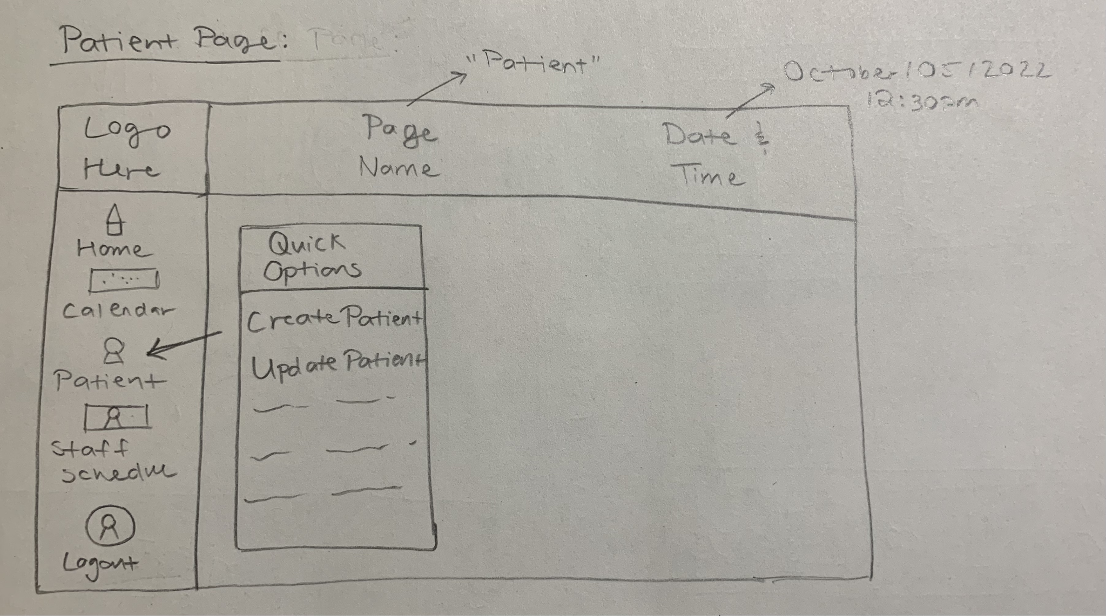
Patient Management Page

Slide 10
Task Step #1 Conclusion
Motivation: High: Begin the process of making a patient file.
Knowledge: High: Buttons are explicitly labelled and the procedure to create the file is straightforward.
Problems and Solutions: N/A.

Slide 11
Task Step #2
Sarah gets the prospective patients' information to create the patient file.
Create patient file.

Slide 12
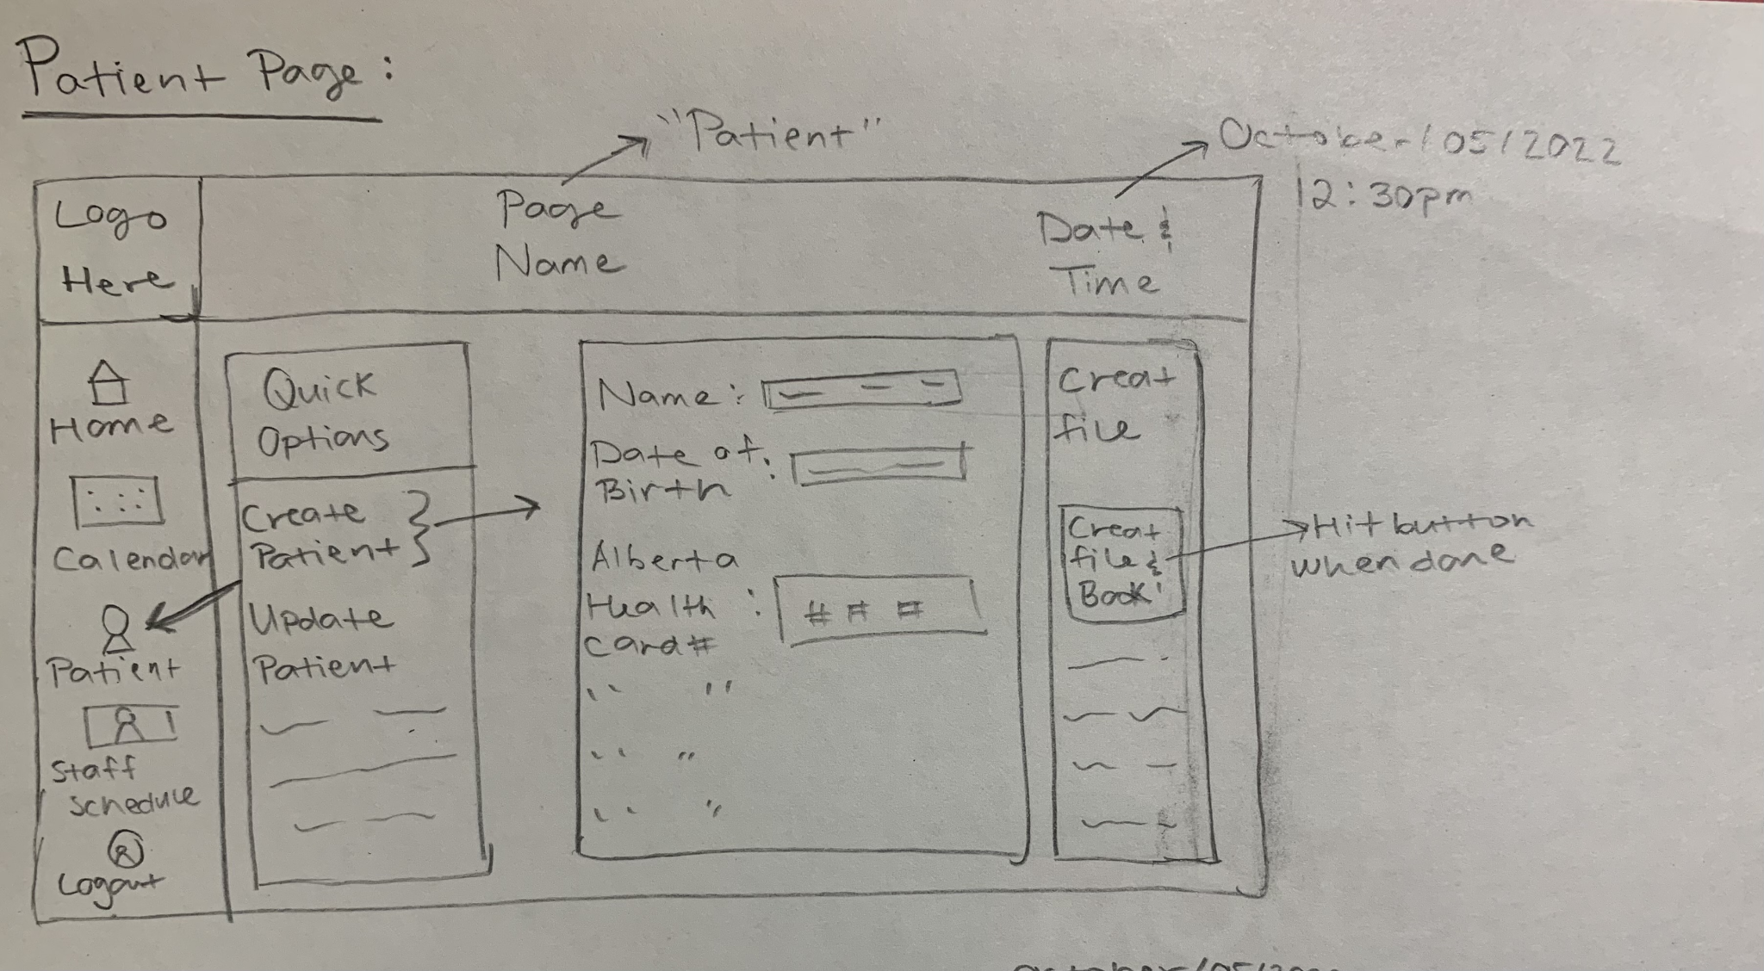
Patient Creation Page

Slide 13
Task Step #2 Conclusion
Motivation: High: They must fill out all the patient information before they’re able to proceed.
Knowledge: Medium: Fields are explicitly labelled, however, patient data must be entered by the staff member.
Problems and Solutions:
Problem #1: A staff member enters the wrong information for the patient.
Solution #1: Add an extra verification page to verify the patient information before continuing to the next step.

Slide 14
Task Step #3
As Sarah has finished creating the patient's file, she will now check the doctor's availability to schedule the patient. Once a time is selected, Sarah now verifies the details of the appointment and books the patient based.
Check appointment availability & finalize appointment.

Slide 15
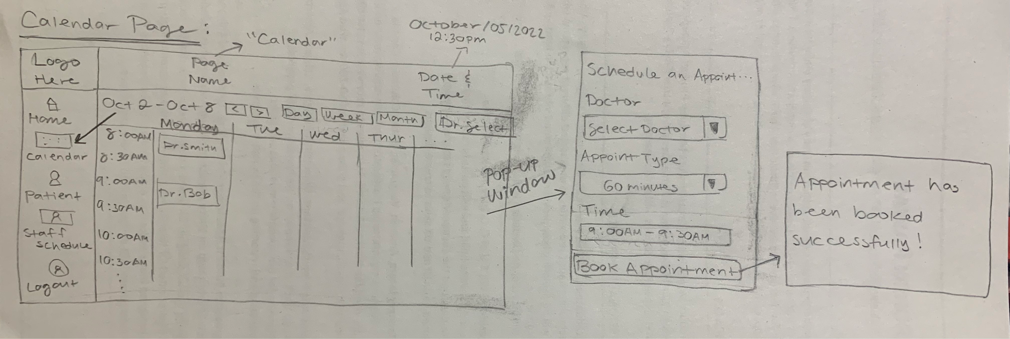
Calendar Page
Notes:
Pop up doctor list all available doctors
We come here from patient page therefore all patient details are transferred over thus Sarah should only Click on time -> select doctor/appointment type and specified time for the booking!

Slide 16
Task Step #3 Conclusion
Motivation: High: They must select a time and doctor to finish scheduling an appointment for the patient.
Knowledge: High: Fields are explicitly labelled, and data is given by the software. (Ex. Time slot selected, doctors available, etc)
Problems and Solutions:
Problem #1: A staff member chooses the wrong doctor for the appointment.
Solution #1: Add an extra verification page to verify all of the appointment details.

Slide 17
Thank you!
Any Questions?

